Slide 1
Category Service Manger Images by Deep CNN
Dai Zhen

Slide 2
Ageda
Purpose
Data source
Model
Tools & Algorithms
Accuracy

Slide 3
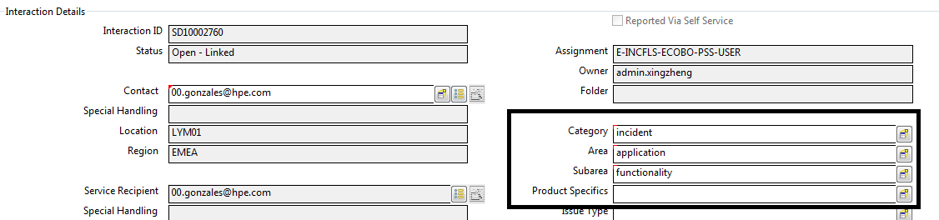
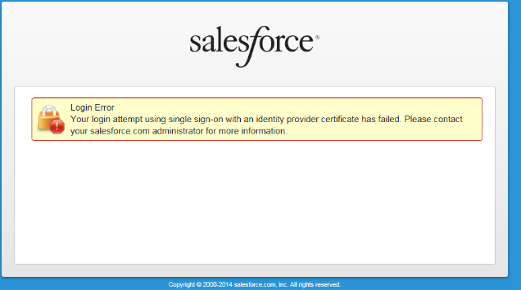
Purpose
Category, subcategory, area and product spec are important for Service Manger ticket.
Is it possible to auto these values by looking at the image?

Slide 4
Data source
Coming from attachments from Service Manager Prod.
Preprocessing 1: Image data
All
Attachments(300,000+)
Pictures
50,000+
Pictures
44,000+
Training set(70%)
Filter
Gray/fixed sze
Split
Validation set(20%)
Test set(10%)

Slide 5
Data source – Preprocessing 2
Create text token vector
Call OCR API from havenondemand
Clean and filter
Generate Token Vector

Slide 6
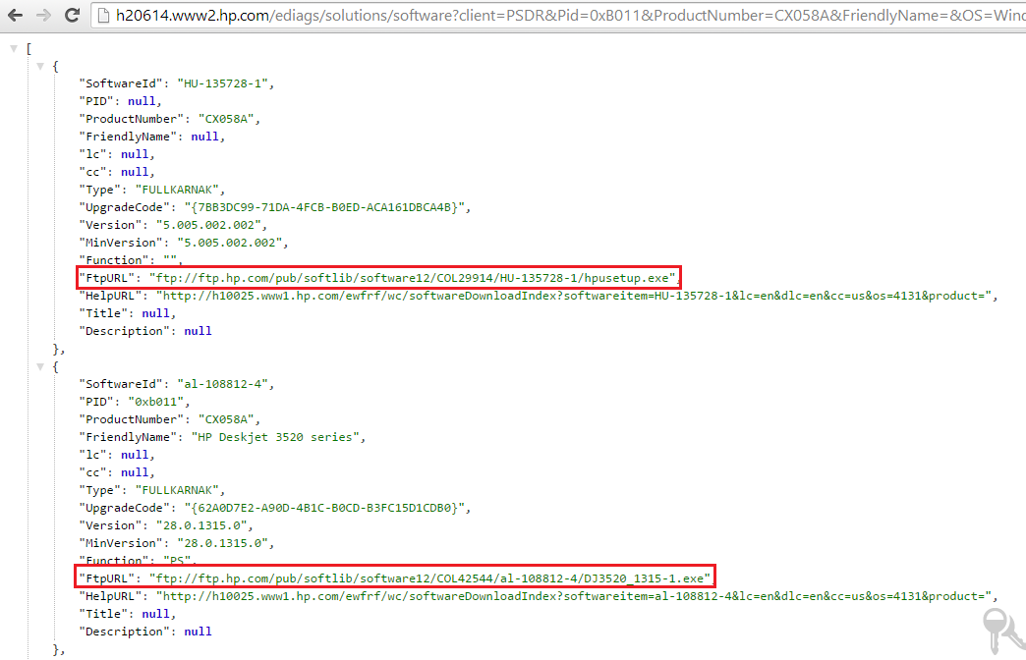
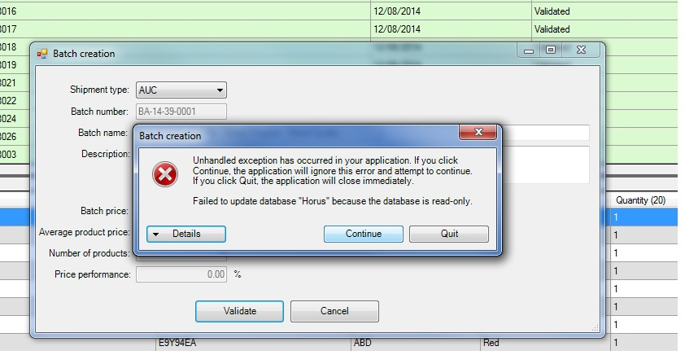
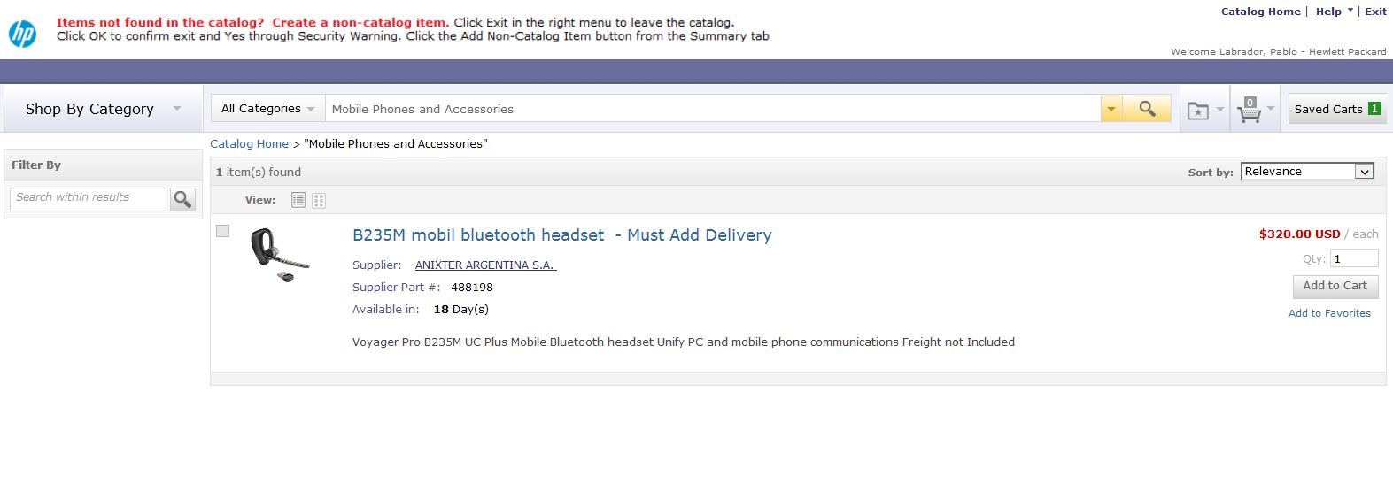
Data source – Sample images
Notes:
Text can provide more information.

Slide 7
Model (CNN)

Slide 8
Tools & Algorithms
Tensorflow + Python
https://dev.havenondemand.com (For OCR)
GD algorithm
NLP

Slide 9
Accuracy
Type | Classes Num | Accuracy
Category | 3 | 79.71%
Subcategory | 25 | 90.54%
Product type(Area) | 111 | 75.41%
Product spec | 294 | 53.49%

Slide 10
Thank you!

